Slide 1
Unit III
PERSONAL AND SOCIAL BRANDING

Slide 2
BRAND?

Slide 3
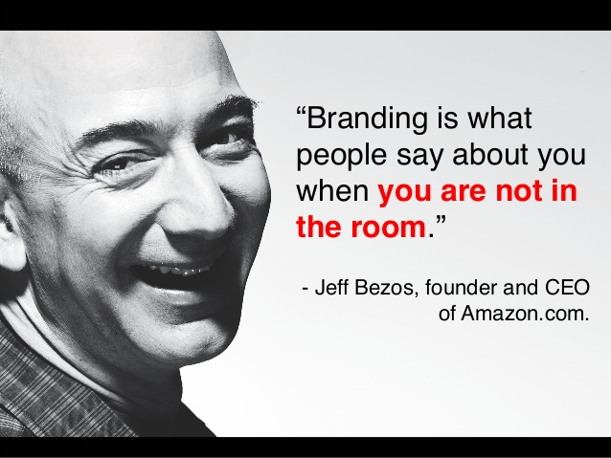

Slide 4


Slide 5
1.) What is personal branding? A. A way to make friends B. A new social media website C. The process by which we market ourselves to others D. None of the above

Slide 6
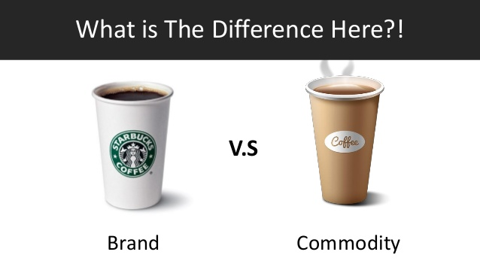

Slide 7
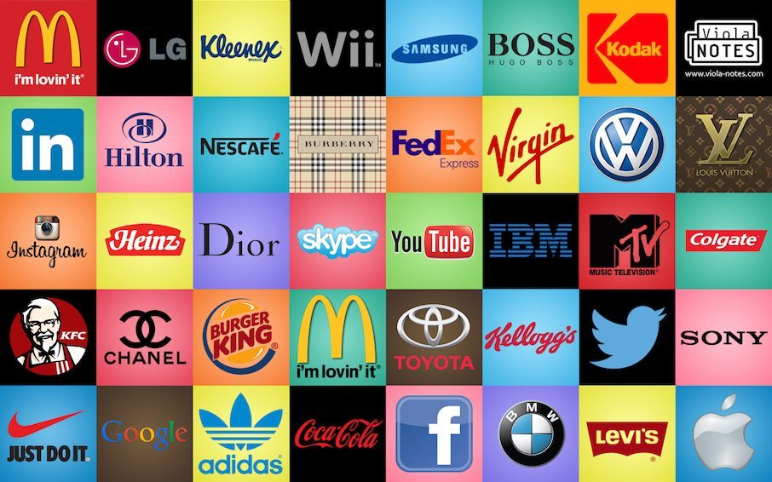
Brands have a value

Slide 8
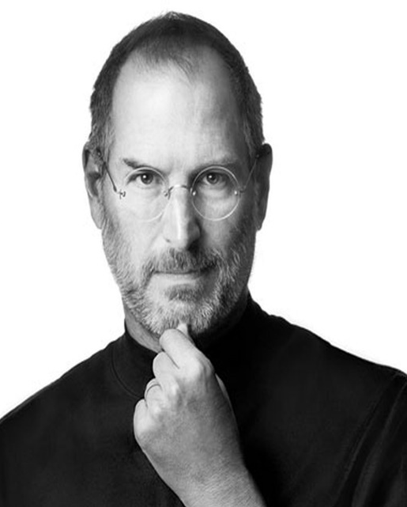

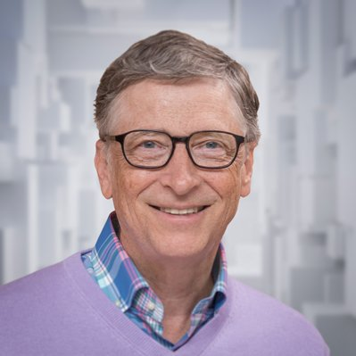
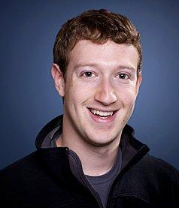
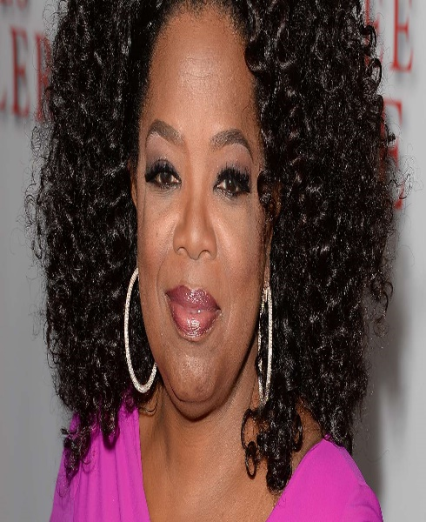
Do you know their brand?

Slide 9
Why personal branding?

Slide 10
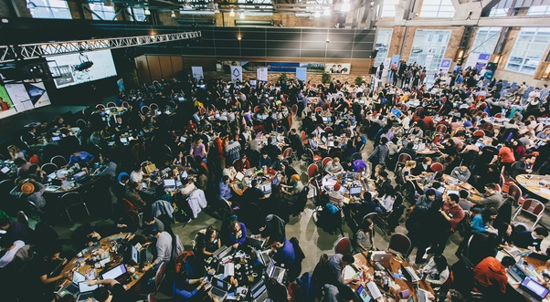
CROWD

Slide 11
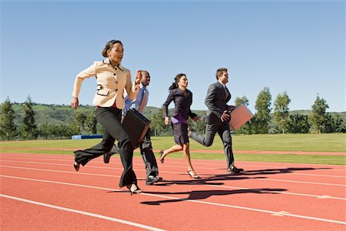
Job competition

Slide 12
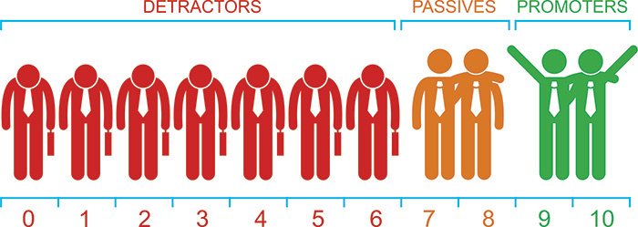
Similarity….Nothing new….

Slide 13


Slide 14


Slide 15
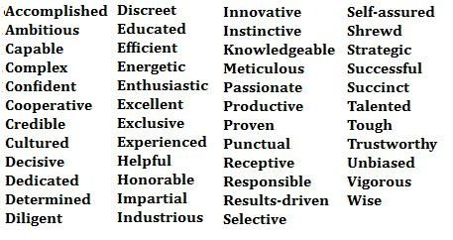
Activity :

Slide 16
Three Words that Describe Me...
_______________ because...
_______________ because...
_______________ because...

Slide 17
Why I need it?

Slide 18
Importance of personal branding.
Popularity
Development
Identity
Reputation
Confidence
Status
Determination
Everlasting
Self fulfillment

Slide 19
Who am I?

Slide 20


Slide 21
Student’s presentation time:

Slide 22
2.) Your self-impression is ________________. A. How people perceive you B. How you view yourself C. Not important D. None of the above

Slide 23
HOW TO CREATE THE IMPACT FOR THAT FIRST IMPRESSION

Slide 24
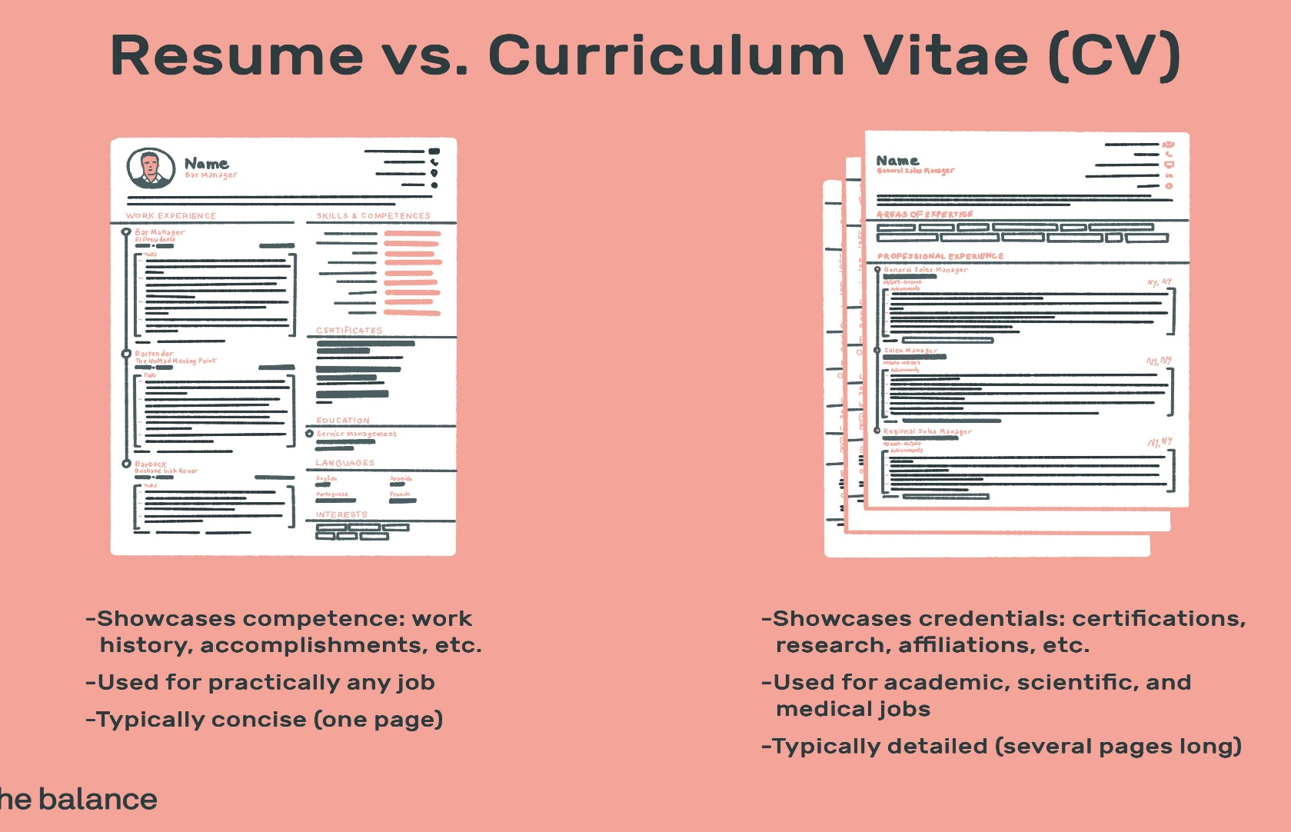

Slide 25
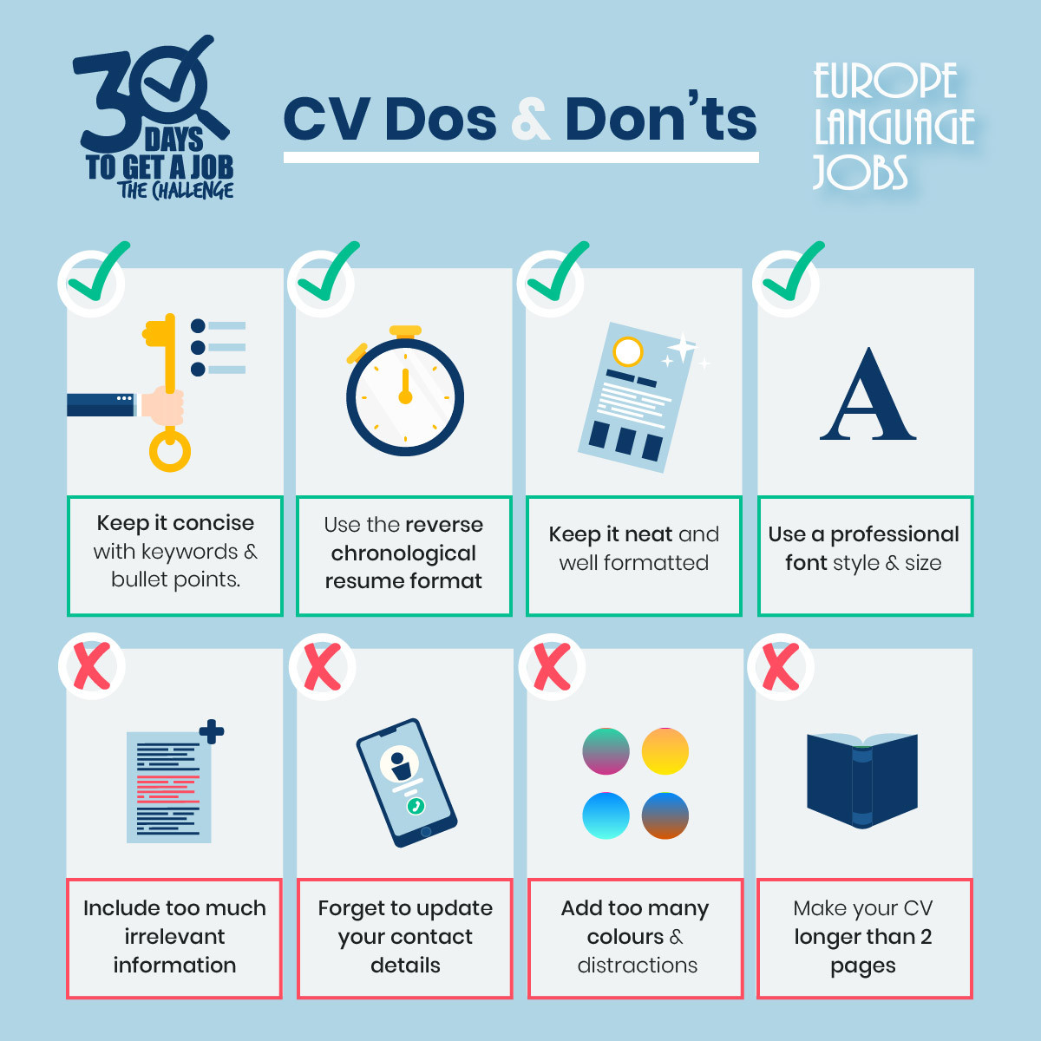

Slide 26
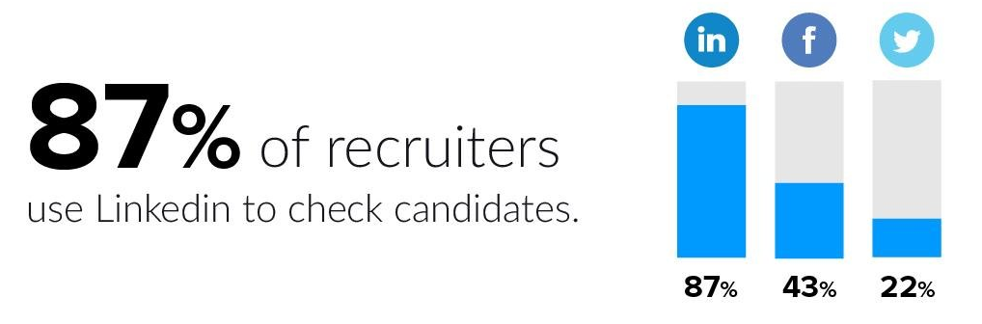
Social branding…

Slide 27
3.) Why has personal branding become so necessary in today’s society? A. The rise of social media B. Popularity of the Internet C. Ease of Googling anything and anybody D. All of the above

Slide 28
Personal grooming.
Your Appearance
Body Language
Smile
Eye Contact
Stance And Posture
How You Sound
What You Have Got To Say

Slide 29
Home task:
Things you like most
Things that others like in you
Things that need improvement

Slide 30
Q & A

Slide 31
Thank You

